Slide 1
Sales Forecasting for Furniture Store
Madhurima Rawat

Slide 2
Index
Introduction
Methodology/ Planning of work
Data Preprocessing
Understanding Data
ARIMA Forecasting
ARIMA Forecasting with hyperparameter tuning
Project Resources

Slide 3
Introduction
1. Objective: Forecast furniture sales in a retail superstore using time series data. Understand components, apply forecasting techniques, and visualize insights for accurate predictions and inventory management.
2. Problem Statement: This project delves into time series data, examining components and employing forecasting techniques for precise sales predictions.

Slide 4
Methodology/ Planning of work
1. Understanding Time Series Data: Diving into the superstore dataset and seeing the fundamentals of time series data.
2. Checking Components of Time Series: Identifying and analyzing the various components of time series data, such as trends and seasonality.
3. Forecasting Techniques: Utilize a range of time series forecasting techniques(ARIMA) to predict furniture sales for the next year.
4. Visualization in Time Series: Developing an understanding of effective visualization techniques for time series data.

Slide 5
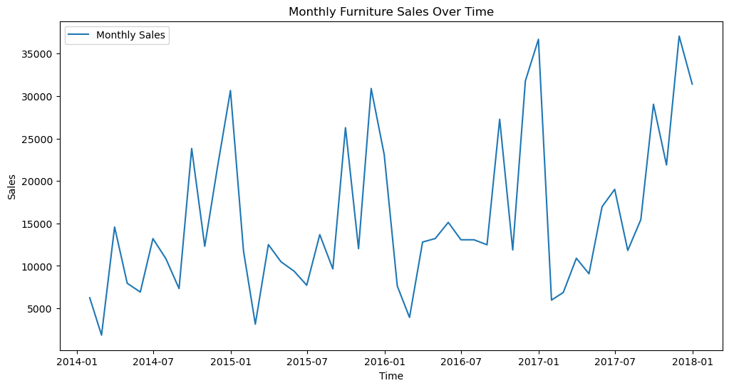
Understanding Data

Slide 6
ARIMA Forecasting
ARIMA: Autoregressive Integrated Moving Average
Autoregressive (AR):
AR component captures the relationship between an observation and its past values.
It signifies the influence of previous time points on the current one.
Integrated (I):
The I component involves differencing the time series data to make it stationary.
Stationarity ensures a constant mean and variance, simplifying modeling.
Moving Average (MA):
It accounts for short-term fluctuations not explained by the autoregressive component.

Slide 7
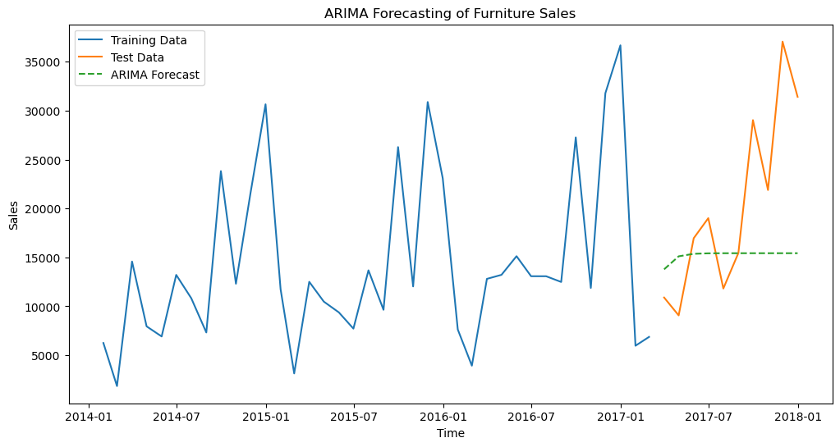
ARIMA Forecasting on dataset

Slide 8
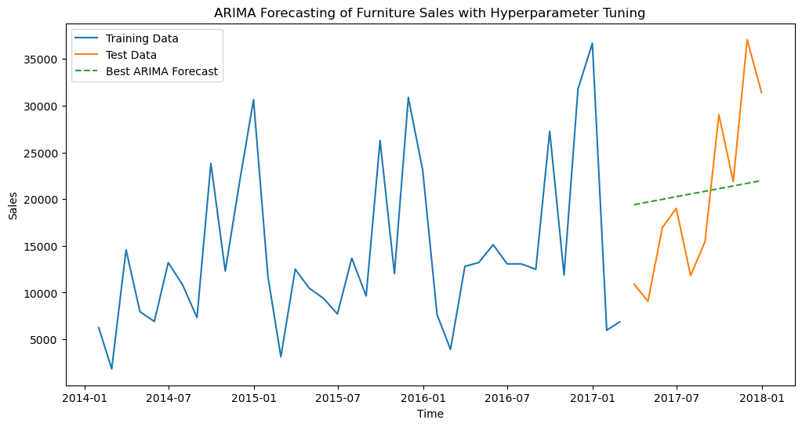
ARIMA Forecasting with hyperparameter tuning

Slide 9
Project Resources
ARIMA Forecasting: Python | ARIMA Model for Time Series Forecasting - GeeksforGeeks
GitHub Repository:
Codes related to this project can be seen at my GitHub Repository:
GitHub Repository Link: Retail Store Forecasting

Slide 10
THANK YOU FOR LISTENING TO MY PRESENTATION
Any questions?

